Slide 1

Angular
Developing SPA with Angular 12
DATE
30th June 2021

Slide 2


Angular Material is a User Interface (UI) component library that developers can use in their Angular projects to speed up the development of elegant and consistent user interfaces.

Slide 3
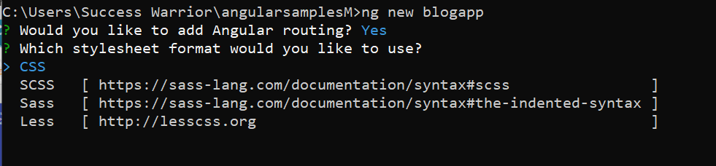

Slide 4
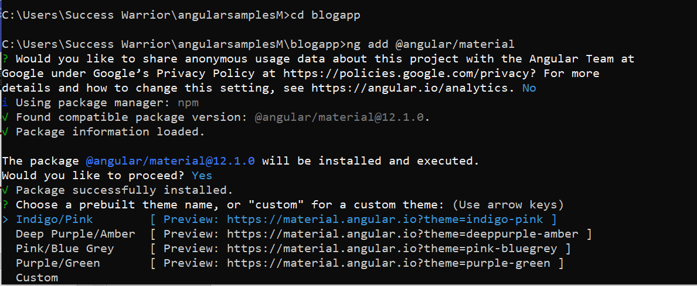
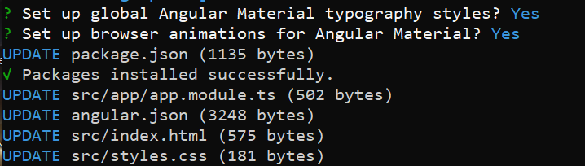

Slide 5
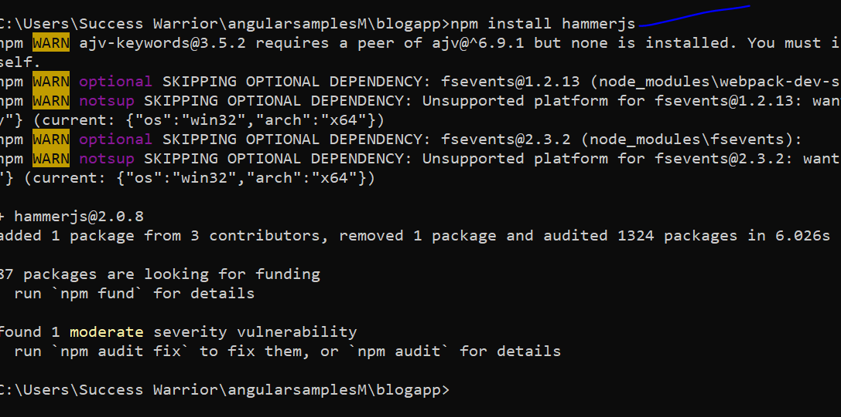

Slide 6
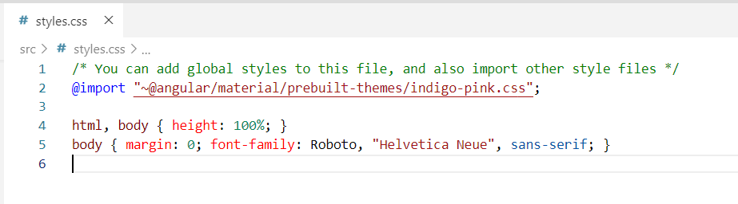

Slide 7
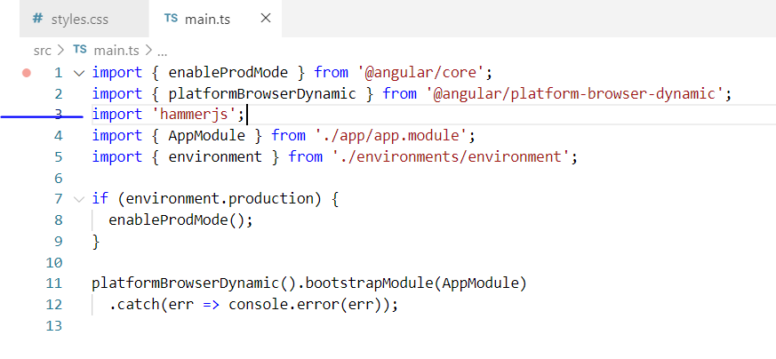

Slide 8
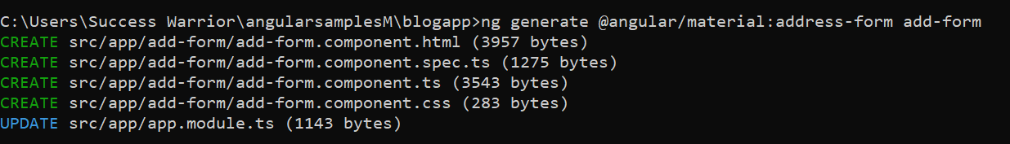
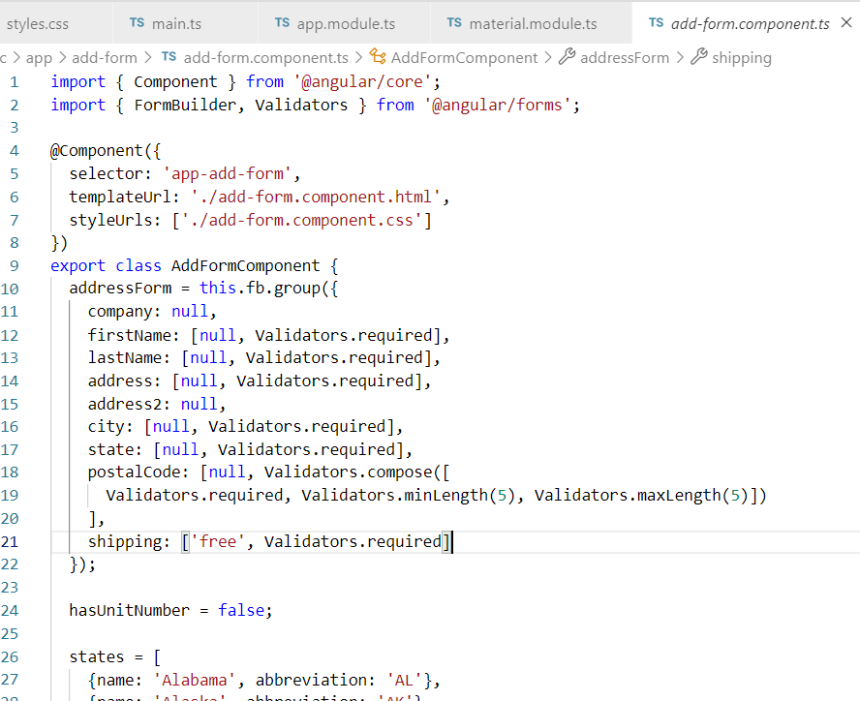

Slide 9
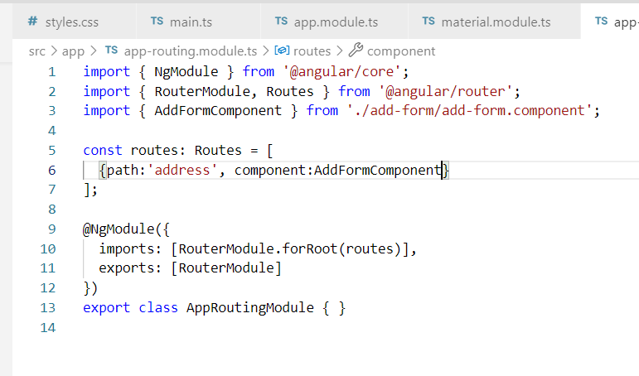

Slide 10
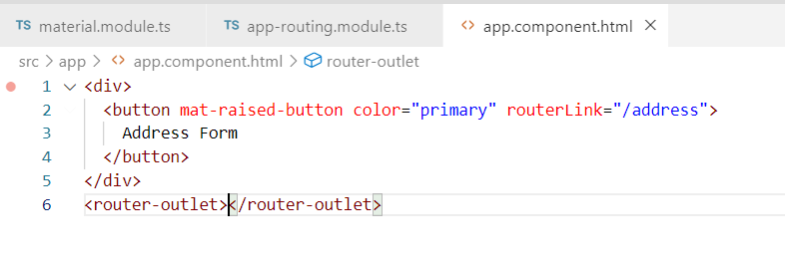

Slide 11
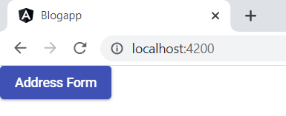
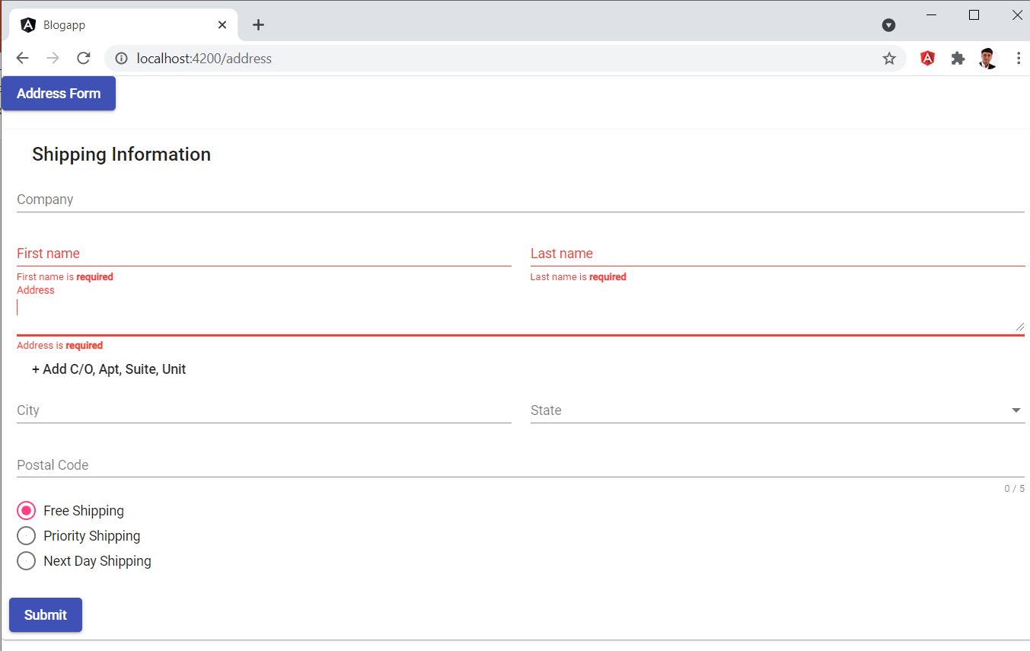

Slide 12
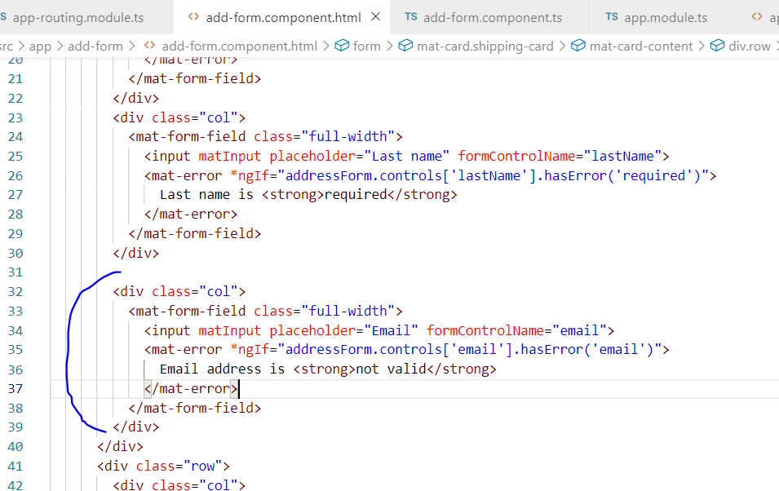

Slide 13
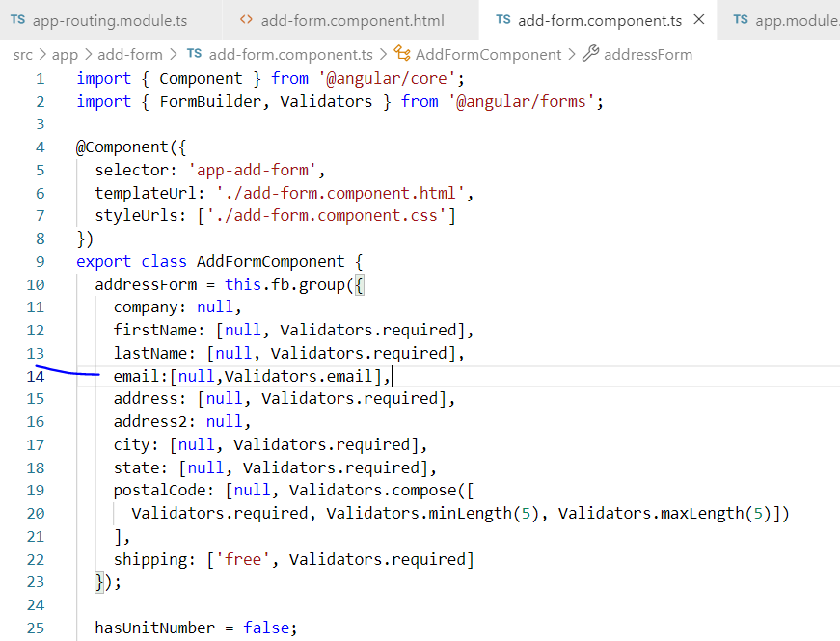

Slide 14
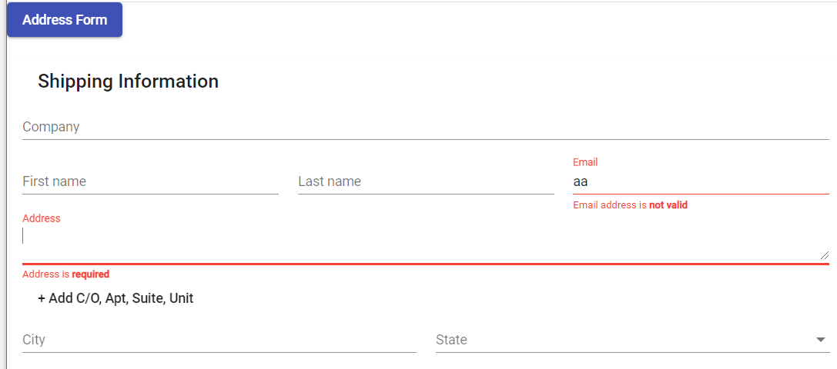

Slide 15
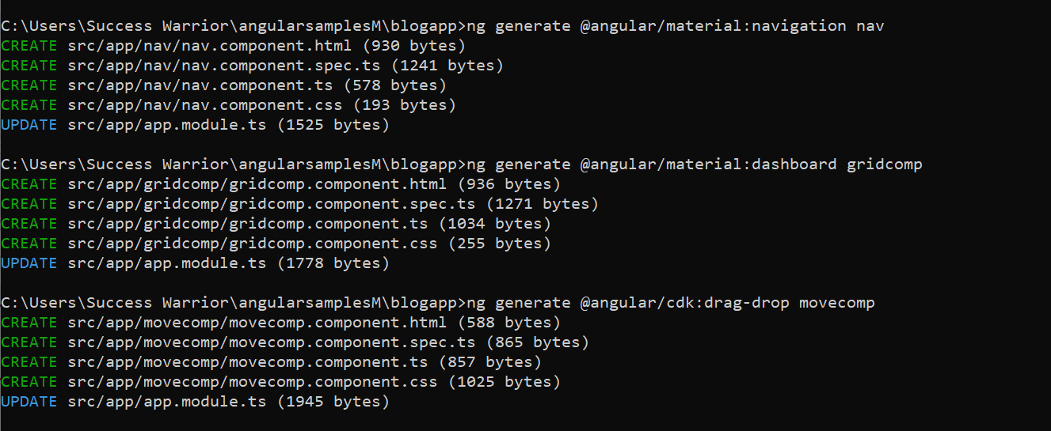

Slide 16
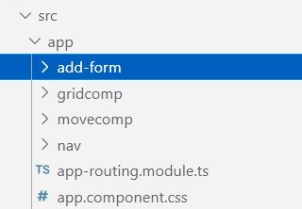

Slide 17
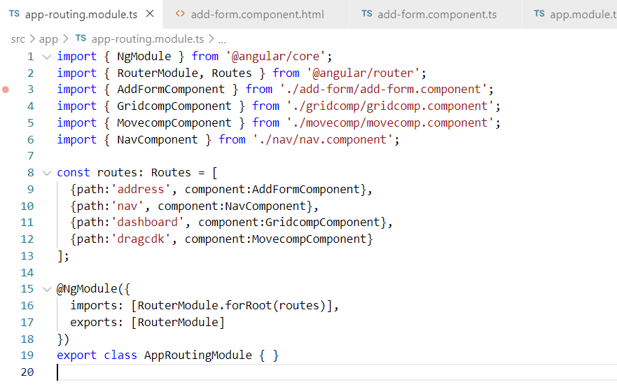

Slide 18
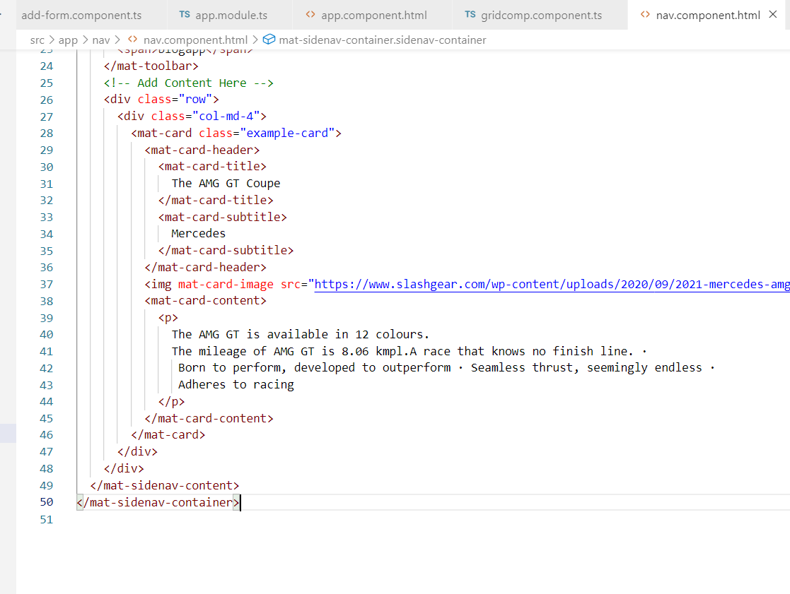

Slide 19
<div class="row">
<div class="col-md-4">
<mat-card class="example-card">
<mat-card-header>
<mat-card-title>
The AMG GT Coupe
</mat-card-title>
<mat-card-subtitle>
Mercedes
</mat-card-subtitle>
</mat-card-header>
<img mat-card-image src="https://www.slashgear.com/wp-content/uploads/2020/09/2021-mercedes-amg-gt-stealth-edition.jpg" alt="photo of a car" width="400">
<mat-card-content>
<p>
The AMG GT is available in 12 colours.
The mileage of AMG GT is 8.06 kmpl.A race that knows no finish line. ·
Born to perform, developed to outperform · Seamless thrust, seemingly endless ·
Adheres to racing
</p>
</mat-card-content>
</mat-card>
</div>
</div>

Slide 20
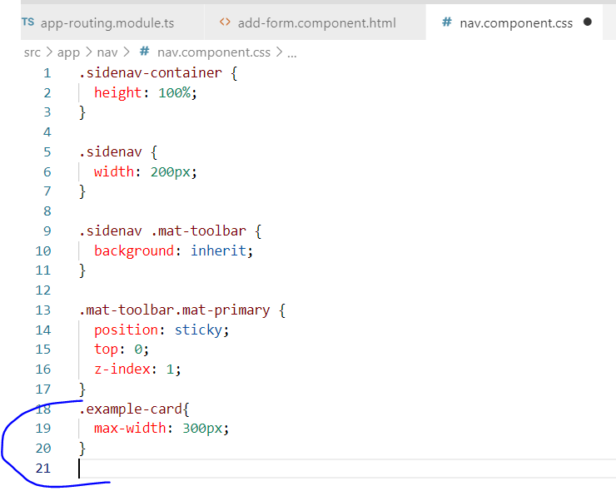

Slide 21
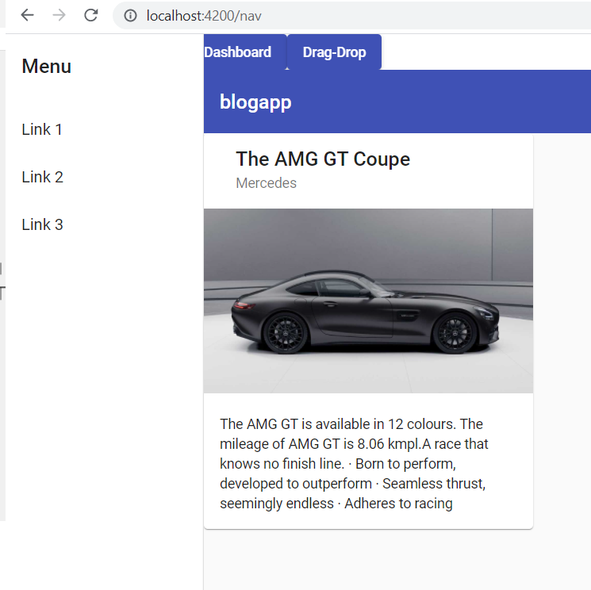

Slide 22
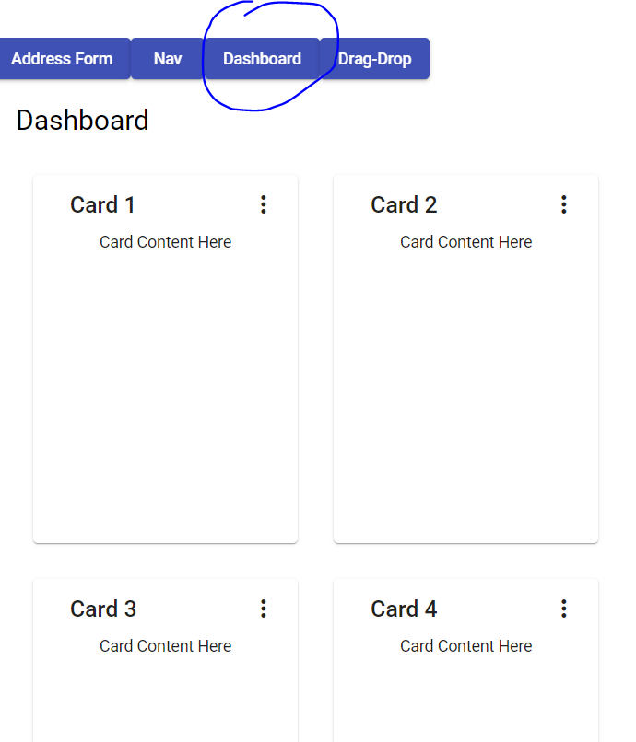

Slide 23
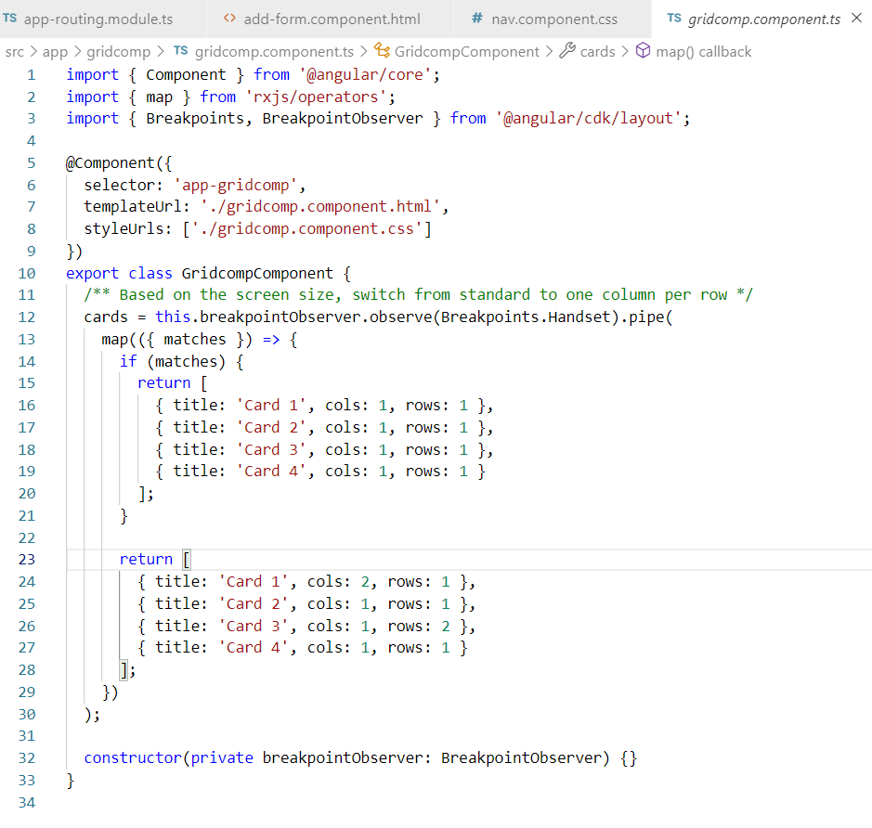

Slide 24
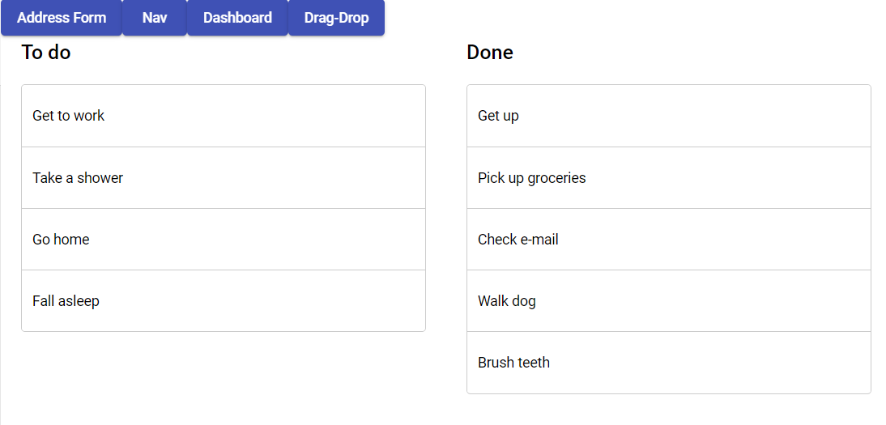

Slide 25
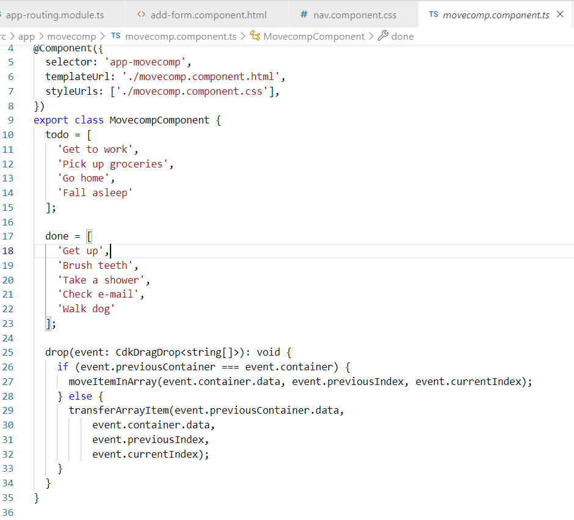

Slide 26
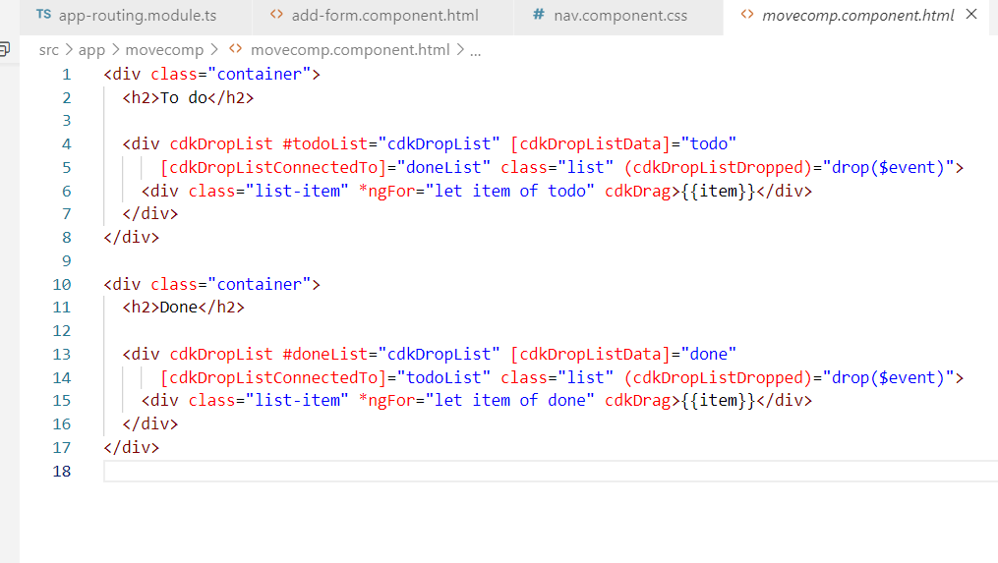

Slide 28
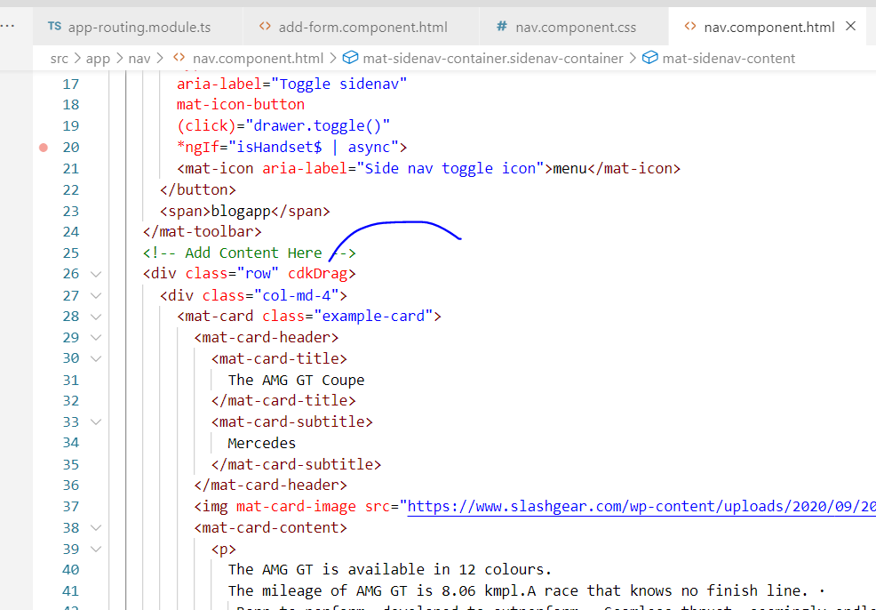

Slide 29
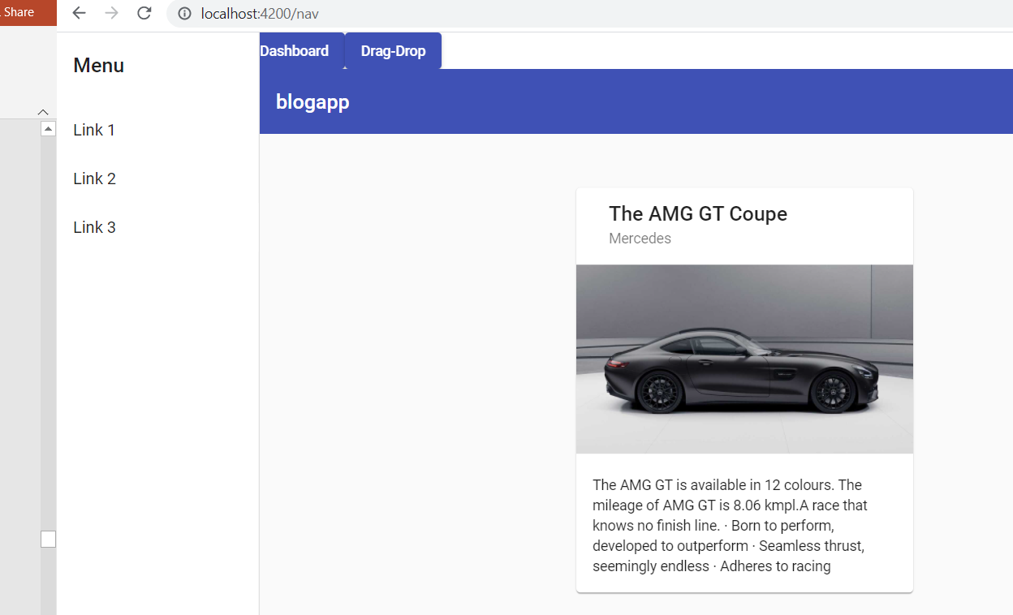

Slide 30
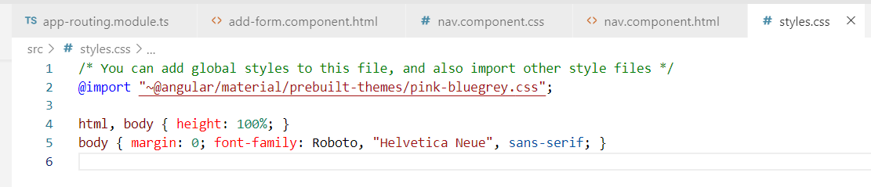

Slide 31
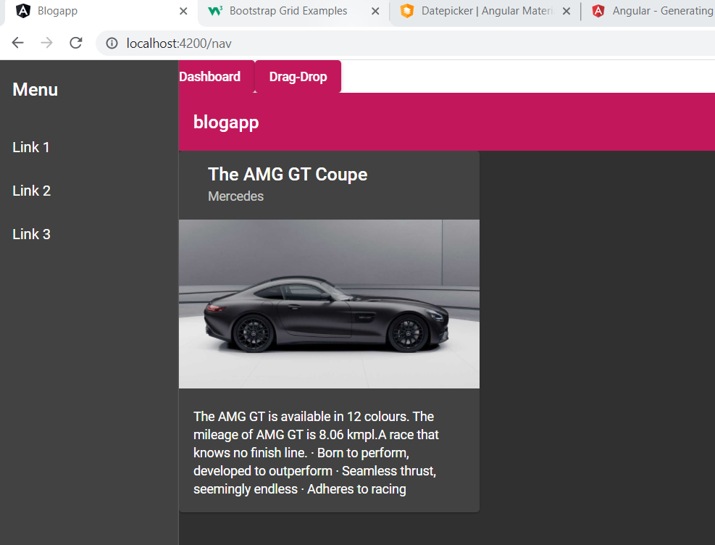

Slide 32
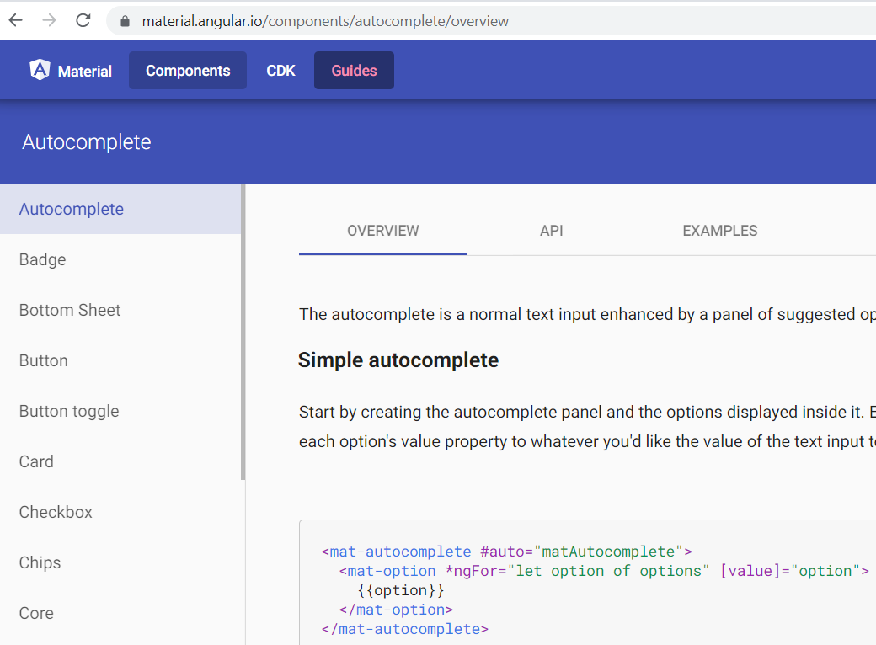
https://material.angular.io/components/autocomplete/overview

Slide 33
https://ej2.syncfusion.com/angular/demos/#/material/gantt/self-reference-data
https://angular-gantt-chart.herokuapp.com/home
https://github.com/YukiDayDreamer/angular-gantt-chart
https://medium.com/@abbq100/create-an-app-for-creating-itself-build-a-gantt-chart-with-angular-6-2827ad4308a4

